Slide 1
GCBASIC
PIC18FxxQ35chip Family
Part 4 – sequence the LEDs

Slide 2

GCBASIC
PIC18FxxQ35 chip Family
Part 4 – sequence the LEDs

Slide 3
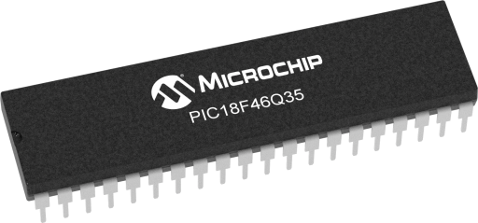
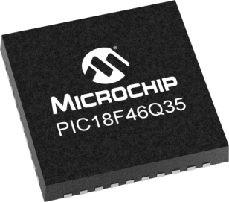
GCBASIC
Like and subscribe!

Slide 4
PIC18FxxQ35
PIC18FxxQ35 is a high performance PIC18
Digital and analog peripherals for flexible embedded control
10-bit ADC for accurate analog signal conversion
Multiple communication interfaces including UART (serial), I²C, and SPI
PWM modules with CCP and 16-bit resolution for precise timing and motor control
Configurable Logic Cells (CLCs) for custom hardware-level logic without external components
Integrated op amps for onboard analog signal conditioning and amplification
The PIC18FxxQ35 offers 28, 40 and 44-pin products in small footprint packages to support customers in a wide variety of applications.

Slide 5
Videos...
Install the hardware and make the board work – make LEDs work
Make four LEDs flash in a sequence
Set the LEDs to represent the value of ADC
Sequence the LEDs with a delay using the value of ADC
Using an input to set the state of the LEDs
Using the reset switch
Using the switch, ADC – make the LEDs flash in a sequence with reverse
Using the serial to display values
Using the timer0 overflow, 8bit timer, 16bit timer to flash the LEDs
Using EEProm – showing values on the serial terminal, and more constants insights
Using I2C with serial to discover I2C devices
Using an I2C GCLD display
Using a SPI GCLD display
Using PWM, many ways, to dim the LEDS
Using an external interrupt to control an LED
Using storage within the chip – Progmem, SAF memory, EEPROM and DATA blocks
Using CLC
The GCBASIC tool chain
Assembly , alternatives assemblers and MPLAB-X
Summary

Slide 6
GCBASIC Compiler
GCBASIC Compiler
GCBASIC is an Open Source compiler for PIC, AVR and LGT microcontrollers
GCBASIC now supports the 18FxxQ35 chip family
GCBASIC now supports 1400+ microcontrollers

Slide 7
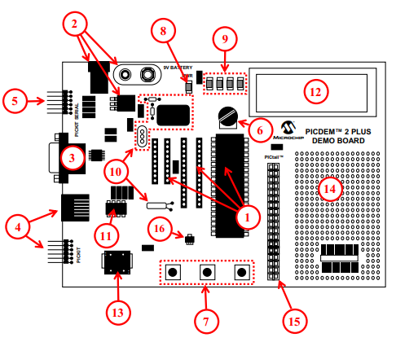
PICDEM 2 Plus Demonstration
Board
1. 18-, 28- and 40-pin DIP sockets
(although three sockets are provided, only one device may be used at a time)
2. On-board, +5V regulator for direct input from 9V, 100 mA AC/DC wall adapter or
9V battery, or hooks for a +5V, 100 mA regulated DC supply
3. RS-232 socket and associated hardware for direct connection to an RS-232
interface
4. Programmer/debugger connectivity supporting MPLAB® ICD 3, MPLAB REAL
ICE and PICkit 3
5. PICkit Serial Connector for analysis of serial communications peripherals such
as SPI or I2C™
6. 5 k pot for devices with analog inputs
7. Three push button switches for external stimulus and Reset
8. Power-on indicator LED
9. Four LEDs connected to PORTB
10. On-board external oscillators including:
a) Unpopulated DIP socket for canned crystal oscillator (Y2)
b) RC oscillator circuit (R4, C3)
c) Unpopulated holes for crystal connection (Y1)
d) 32.768 kHz crystal for Timer1 clock operation (Y3) 11. 32K x 8 Serial EEPROM
12. LCD display
13. Piezo buzzer
14. Prototype area for user hardware
15. Expansion Header for PICtail™ daughter card connectivity or user access to
MCU pins
16. Microchip TC74 thermal sensor

Slide 8
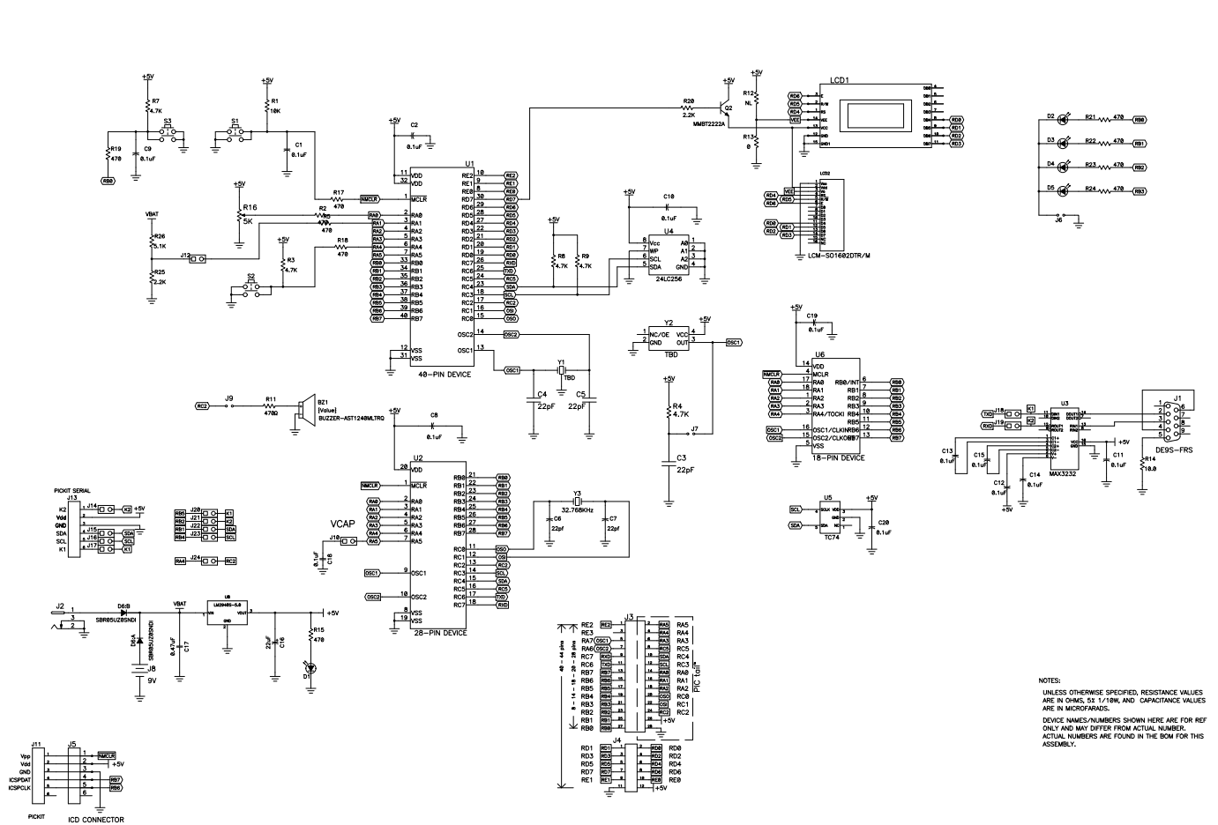
PICDEM 2 Plus Demonstration
Board

Slide 9
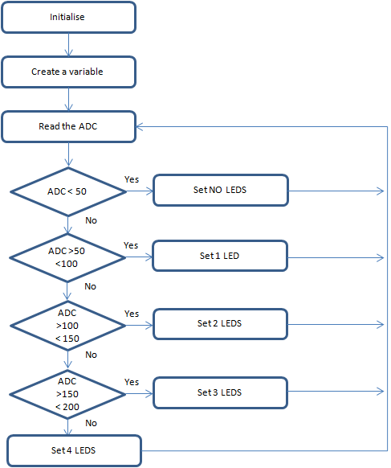
Analog-to-Digital
GCBASIC completes the initialisation
Create a variable to store the ADC results
Read the ADC
GCBASIC makes the process easy via the ReadAD10()
ReadAD10 returns a value of 0 to 4095
Wait for a time period based on returned ADC value
Set the LEDs
Do it again….

Slide 10
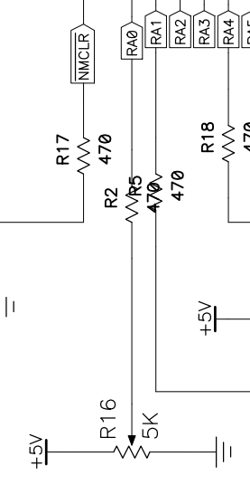
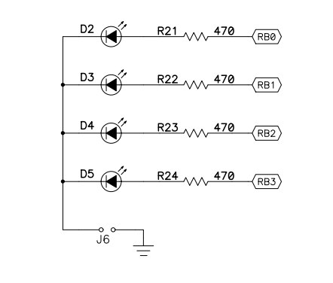
Analog-to-Digital

Slide 11
Time
`WAIT` in GCBASIC creates a software delay loop based on the PIC’s instruction cycle, which is the oscillator frequency divided by four.
Changing the OSC frequency changes the instruction timing, so GCBASIC recalculates the loop to keep the delay accurate.
If the oscillator configuration doesn’t match the real hardware clock, all `WAIT` delays will run too fast or too slow.
The tutoral combines previous tutorials by using the Analog-to-Digital Converter (ADC) to control the speed of rotation.
Where speed is a time delay
us, 10us, ms, 10ms, s, m or h
wait time unit
wait 1 ms

Slide 12
Wait
Initialise
Set 1st LED
Read ADC 12 bit
( 0 – 4095)
Time delays are sometimes key to the operation of a program
Wait for a Delay
Rotate the LEDs
Did it overflow ?
No
Yes
Set 1st LED

Slide 13
Rotate with Carry
 | LEDD3 | LEDD2 | LEDD1 | LEDD0 | CARRY = SREG.0
Start | 1 | 0 | 0 | 0 | 0
Rotate(shift) | 0 | 1 | 0 | 0 | 0
Rotate(shift) | 0 | 0 | 1 | 0 | 0
Rotate(shift) | 0 | 0 | 0 | 1 | 0
Rotate(shift) | 0 | 0 | 0 | 0 | 1
Restart | 1 | 0 | 0 | 0 | 0
Rotate(shift) | 0 | 1 | 0 | 0 | 0

Slide 14
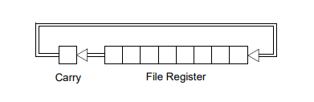
Rotate with Carry
 | LEDD4 = C.4 | LEDD2 | LEDD1 | LEDD0 | CARRY = SREG.0
Start | 1 | 0 | 0 | 0 | 0
Rotate(shift) | 0 | 1 | 0 | 0 | 0
Rotate(shift) | 0 | 0 | 1 | 0 | 0
Rotate(shift) | 0 | 0 | 0 | 1 | 0
Rotate(shift) | 0 | 0 | 0 | 0 | 1
Restart | 1 | 0 | 0 | 0 | 0
Rotate(shift) | 0 | 1 | 0 | 0 | 0

Slide 15
Rotate with Carry
 | LEDD4 = C.4 | LEDD2 | LEDD1 | LEDD0 | CARRY = SREG.0
Start | 1 | 0 | 0 | 0 | 0
Rotate(shift) | 0 | 1 | 0 | 0 | 0
Rotate(shift) | 0 | 0 | 1 | 0 | 0
Rotate(shift) | 0 | 0 | 0 | 1 | 0
Rotate(shift) | 0 | 0 | 0 | 0 | 1
Restart | 1 | 0 | 0 | 0 | 0
Rotate(shift) | 0 | 1 | 0 | 0 | 0

Slide 16
Rotate with Carry
 | LEDD4 = C.4 | LEDD2 | LEDD1 | LEDD0 | CARRY = SREG.0
Start | 1 | 0 | 0 | 0 | 0
Rotate(shift) | 0 | 1 | 0 | 0 | 0
Rotate(shift) | 0 | 0 | 1 | 0 | 0
Rotate(shift) | 0 | 0 | 0 | 1 | 0
Rotate(shift) | 0 | 0 | 0 | 0 | 1
Restart | 1 | 0 | 0 | 0 | 0
Rotate(shift) | 0 | 1 | 0 | 0 | 0

Slide 17
Rotate with Carry
 | LEDD4 = C.4 | LEDD2 | LEDD1 | LEDD0 | CARRY = SREG.0
Start | 1 | 0 | 0 | 0 | 0
Rotate(shift) | 0 | 1 | 0 | 0 | 0
Rotate(shift) | 0 | 0 | 1 | 0 | 0
Rotate(shift) | 0 | 0 | 0 | 1 | 0
Rotate(shift) | 0 | 0 | 0 | 0 | 1
Restart | 1 | 0 | 0 | 0 | 0
Rotate(shift) | 0 | 1 | 0 | 0 | 0

Slide 18
Rotate with Carry
 | LEDD4 = C.4 | LEDD2 | LEDD1 | LEDD0 | CARRY = SREG.0
Start | 1 | 0 | 0 | 0 | 0
Rotate(shift) | 0 | 1 | 0 | 0 | 0
Rotate(shift) | 0 | 0 | 1 | 0 | 0
Rotate(shift) | 0 | 0 | 0 | 1 | 0
Rotate(shift) | 0 | 0 | 0 | 0 | 1
Restart | 1 | 0 | 0 | 0 | 0
Rotate(shift) | 0 | 1 | 0 | 0 | 0

Slide 19
Rotate with Carry
 | LEDD4 = C.4 | LEDD2 | LEDD1 | LEDD0 | CARRY = SREG.0
Start | 1 | 0 | 0 | 0 | 0
Rotate(shift) | 0 | 1 | 0 | 0 | 0
Rotate(shift) | 0 | 0 | 1 | 0 | 0
Rotate(shift) | 0 | 0 | 0 | 1 | 0
Rotate(shift) | 0 | 0 | 0 | 0 | 1
Restart | 1 | 0 | 0 | 0 | 0
Rotate(shift) | 0 | 1 | 0 | 0 | 0

Slide 20
Carry Test
Initialise
Set 1st LED
Read ADC 12 bit
( 0 – 4095 )
Did it overflow ?
If C = 1 then .. Or other test condition
Wait for a Delay
Rotate the LEDs
Did it overflow ?
No
Yes
Set 1st LED

Slide 21
Scale
Initialise
Set 1st LED
Read ADC
Scale transforms an existing value to a new value within a specified scale
Wait for a Delay
Scale()
( 50 – 1000)
Rotate the LEDs
Did it overflow ?
No
Yes
Set 1st LED

Slide 22
Workshop
Read the ADC to set the LEDs
Uses
A Word variable
Simple logic
Rotate
Bitwise mask
Scale()

Slide 24
Videos...
Install the hardware and make the board work – three LED programs
Make four LEDs flash in a sequence
Set the LEDs to represent the value of ADC
Sequence the LEDs with a delay using the value of ADC
Using an input to set the state of the LEDs
Using the reset switch
Using the switch, ADC – make the LEDs flash in a sequence with reverse
Using the serial to display values
Using the timer0 overflow, 8bit timer, 16bit timer to flash the LEDs
Using EEProm – showing values on the serial terminal, and more constants insights
Using I2C with serial to discover I2C devices
Using an I2C GCLD display
Using a SPI GCLD display
Using PWM, 7 ways, to dim the LEDS
Using an external interrupt to control an LED
Using storage within the chip – Progmem, SAF memory, EEPROM and DATA blocks
Using CLC
The GCBASIC tool chain
Assembly , alternatives assemblers and MPLAB-X
Summary

Slide 25
GCBASIC
PIC18FxxQ35 chip Family
Part 4 – sequence the LEDs

